Slide 1

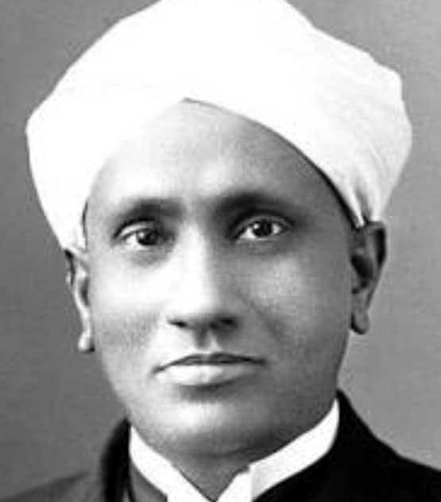
pdz %& 7- fuf[kye~ xq.kk & rhu la[;kvks dk ¼vk/kkj 1000]fopyu /kukRed rFkk 10 ls cMk ugh½

Slide 2
1
00:30
00:29
00:28
00:27
00:26
00:25
00:24
00:23
00:22
00:21
00:20
00:19
00:18
00:17
00:16
00:15
00:14
00:13
00:12
00:11
00:10
00:09
00:08
00:07
00:06
00:05
00:04
00:03
00:02
00:01
00:00
1 0 0 3
1 0 0 4
1 0 0 7
1014 061 084

Slide 3
2
00:30
00:29
00:28
00:27
00:26
00:25
00:24
00:23
00:22
00:21
00:20
00:19
00:18
00:17
00:16
00:15
00:14
00:13
00:12
00:11
00:10
00:09
00:08
00:07
00:06
00:05
00:04
00:03
00:02
00:01
00:00
1 0 0 6
1 0 0 4
1 0 0 7
1017 094 168

Slide 4
3
00:30
00:29
00:28
00:27
00:26
00:25
00:24
00:23
00:22
00:21
00:20
00:19
00:18
00:17
00:16
00:15
00:14
00:13
00:12
00:11
00:10
00:09
00:08
00:07
00:06
00:05
00:04
00:03
00:02
00:01
00:00
1 0 0 5
1 0 0 3
1 0 0 6
1014 063 090

Slide 5
4
00:30
00:29
00:28
00:27
00:26
00:25
00:24
00:23
00:22
00:21
00:20
00:19
00:18
00:17
00:16
00:15
00:14
00:13
00:12
00:11
00:10
00:09
00:08
00:07
00:06
00:05
00:04
00:03
00:02
00:01
00:00
1 0 0 6
1 0 0 2
1 0 0 8
1016 076 096

Slide 6
5
00:30
00:29
00:28
00:27
00:26
00:25
00:24
00:23
00:22
00:21
00:20
00:19
00:18
00:17
00:16
00:15
00:14
00:13
00:12
00:11
00:10
00:09
00:08
00:07
00:06
00:05
00:04
00:03
00:02
00:01
00:00
1 0 0 4
1 0 0 6
1 0 0 2
1012 044 048

Slide 7
6
00:30
00:29
00:28
00:27
00:26
00:25
00:24
00:23
00:22
00:21
00:20
00:19
00:18
00:17
00:16
00:15
00:14
00:13
00:12
00:11
00:10
00:09
00:08
00:07
00:06
00:05
00:04
00:03
00:02
00:01
00:00
1 0 0 3
1 0 0 6
1 0 0 5
1014 063 090

Slide 8
7
00:30
00:29
00:28
00:27
00:26
00:25
00:24
00:23
00:22
00:21
00:20
00:19
00:18
00:17
00:16
00:15
00:14
00:13
00:12
00:11
00:10
00:09
00:08
00:07
00:06
00:05
00:04
00:03
00:02
00:01
00:00
1 0 0 4
1 0 0 6
1 0 0 5
1015 074 120

Slide 9
8
00:30
00:29
00:28
00:27
00:26
00:25
00:24
00:23
00:22
00:21
00:20
00:19
00:18
00:17
00:16
00:15
00:14
00:13
00:12
00:11
00:10
00:09
00:08
00:07
00:06
00:05
00:04
00:03
00:02
00:01
00:00
1 0 0 4
1 0 0 7
1 0 0 3
1014 061 084

Slide 10
9
00:30
00:29
00:28
00:27
00:26
00:25
00:24
00:23
00:22
00:21
00:20
00:19
00:18
00:17
00:16
00:15
00:14
00:13
00:12
00:11
00:10
00:09
00:08
00:07
00:06
00:05
00:04
00:03
00:02
00:01
00:00
1 0 0 2
1 0 0 6
1 0 0 3
1011 036 036

Slide 11
10
00:30
00:29
00:28
00:27
00:26
00:25
00:24
00:23
00:22
00:21
00:20
00:19
00:18
00:17
00:16
00:15
00:14
00:13
00:12
00:11
00:10
00:09
00:08
00:07
00:06
00:05
00:04
00:03
00:02
00:01
00:00
1 0 0 2
1 0 0 4
1 0 0 8
1014 056 064

Slide 12
11
00:30
00:29
00:28
00:27
00:26
00:25
00:24
00:23
00:22
00:21
00:20
00:19
00:18
00:17
00:16
00:15
00:14
00:13
00:12
00:11
00:10
00:09
00:08
00:07
00:06
00:05
00:04
00:03
00:02
00:01
00:00
1 0 0 3
1 0 0 6
1 0 0 7
1016 081 126

Slide 13
12
00:30
00:29
00:28
00:27
00:26
00:25
00:24
00:23
00:22
00:21
00:20
00:19
00:18
00:17
00:16
00:15
00:14
00:13
00:12
00:11
00:10
00:09
00:08
00:07
00:06
00:05
00:04
00:03
00:02
00:01
00:00
1 0 0 3
1 0 0 4
1 0 0 8
1015 068 096

Slide 14
13
00:30
00:29
00:28
00:27
00:26
00:25
00:24
00:23
00:22
00:21
00:20
00:19
00:18
00:17
00:16
00:15
00:14
00:13
00:12
00:11
00:10
00:09
00:08
00:07
00:06
00:05
00:04
00:03
00:02
00:01
00:00
1 0 0 4
1 0 0 7
1 0 0 3
1014 061 084

Slide 15
14
00:30
00:29
00:28
00:27
00:26
00:25
00:24
00:23
00:22
00:21
00:20
00:19
00:18
00:17
00:16
00:15
00:14
00:13
00:12
00:11
00:10
00:09
00:08
00:07
00:06
00:05
00:04
00:03
00:02
00:01
00:00
1 0 0 6
1 0 0 4
1 0 0 8
1018 104 192

